Slide 1
Control Structures
C has three control structures (loops): the while, the for, and the do…while. The first two are pretest loops, and the
the third is a post-test loop. We can use all of them
for event-controlled and counter-controlled loops.
Topics discussed in this section:
The while Loop
The for Loop
The do…while Loop
The Comma Expression

Slide 2
Loop Constructs

Slide 3
The while Statement

Slide 4
Compound while Statement

Slide 5
Process-control System Example

Slide 6
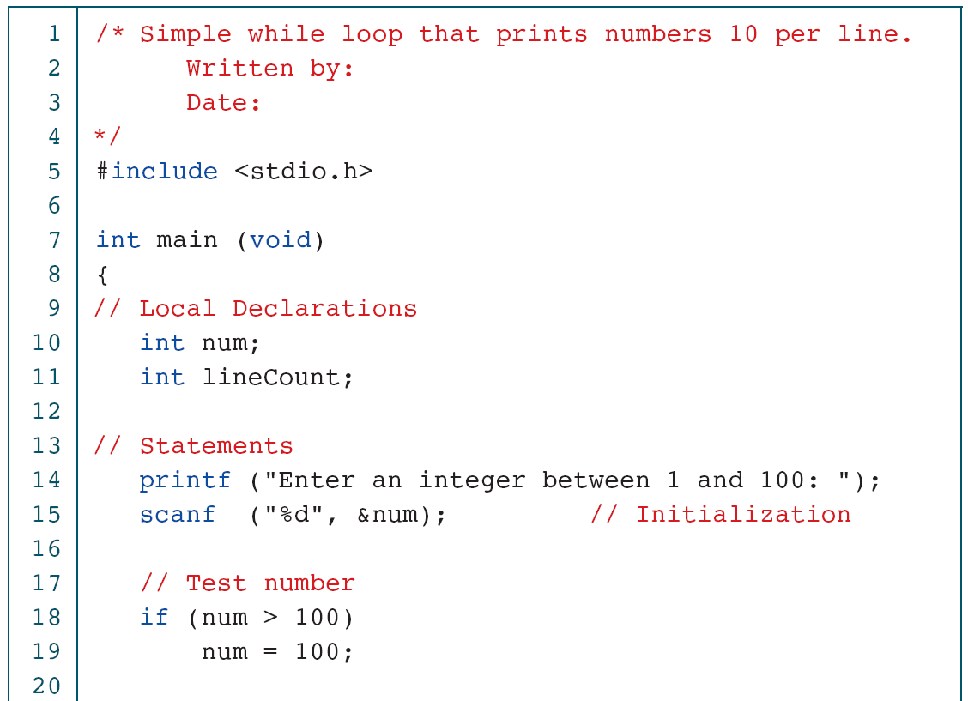
A while Loop to Print Numbers

Slide 7
A while Loop to Print Numbers

Slide 8
Adding a List of Numbers

Slide 9
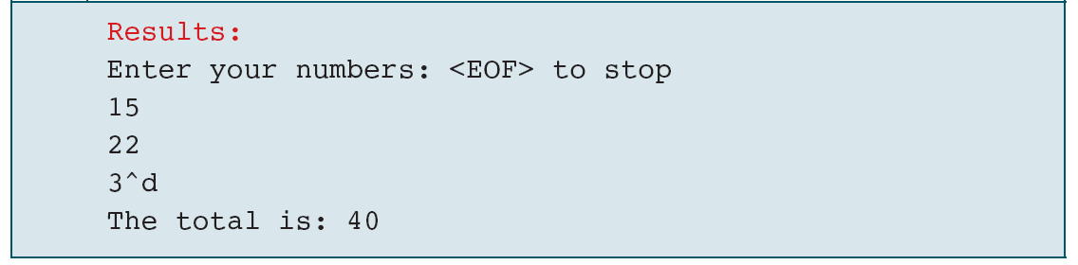
Adding a List of Numbers

Slide 10
Note
A for loop is used when a loop is to be executed a known number of times. We can do the same thing with a while loop, but the for loop is easier to read and
more natural for counting loops.

Slide 11
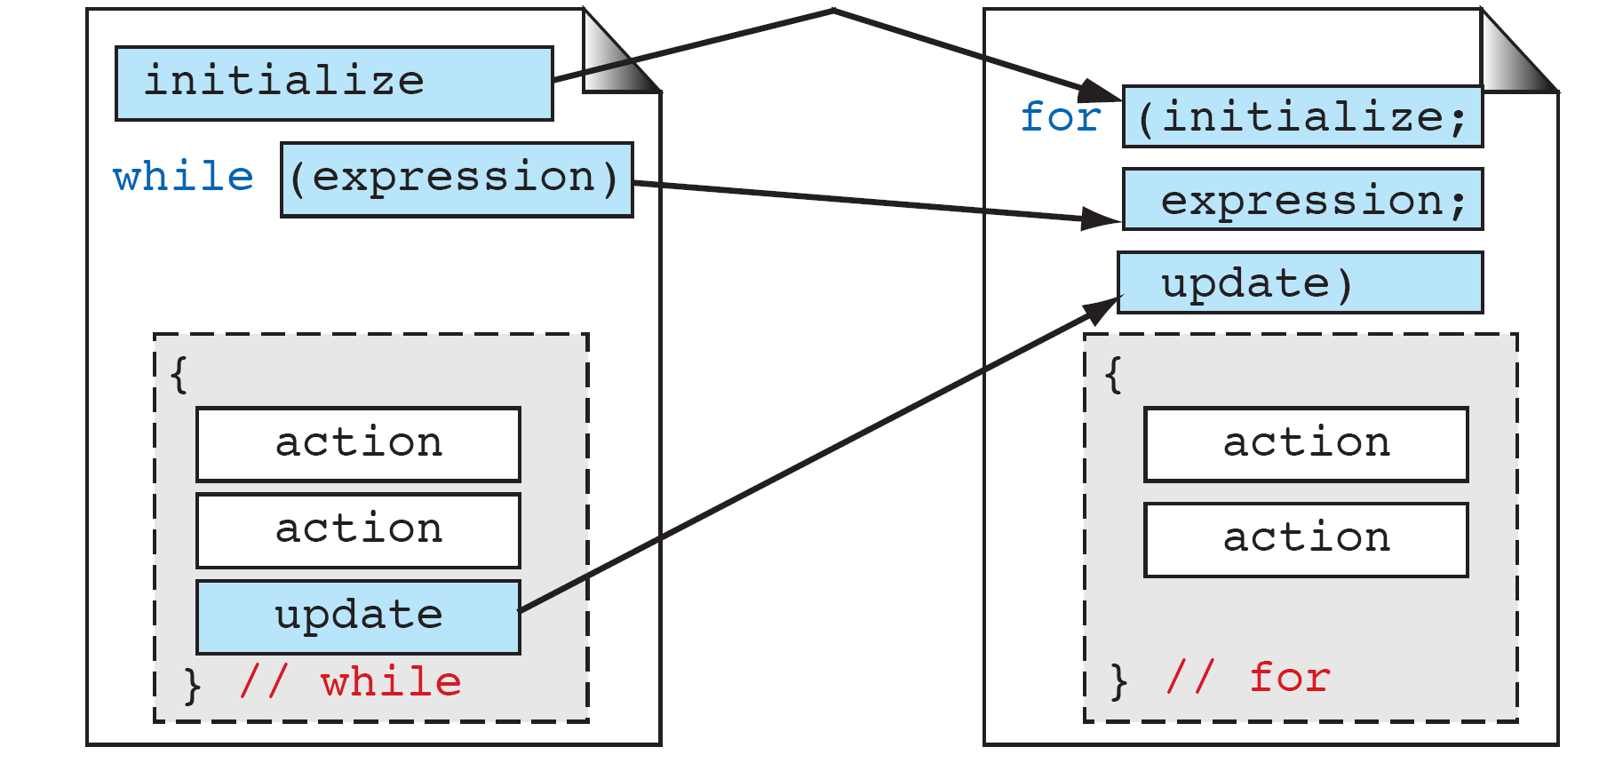
Comparing for and while Loops

Slide 12
Example of a for Loop

Slide 13
Example of a for Loop

Slide 14
A Simple Nested for Loop

Slide 15
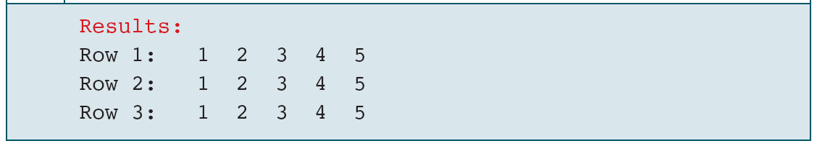
A Simple Nested for Loop

Slide 16
do…while Statement

Slide 17
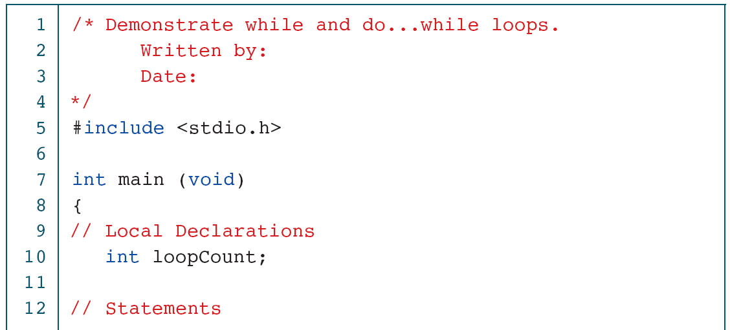
Two Simple Loops

Slide 18
Two Simple Loops

Slide 19
Pre- and Post-test Loops

Slide 20
Adding a List with the do…while

Slide 21
Adding a List with the do…while

Slide 22
Nested Comma Expression

Slide 23
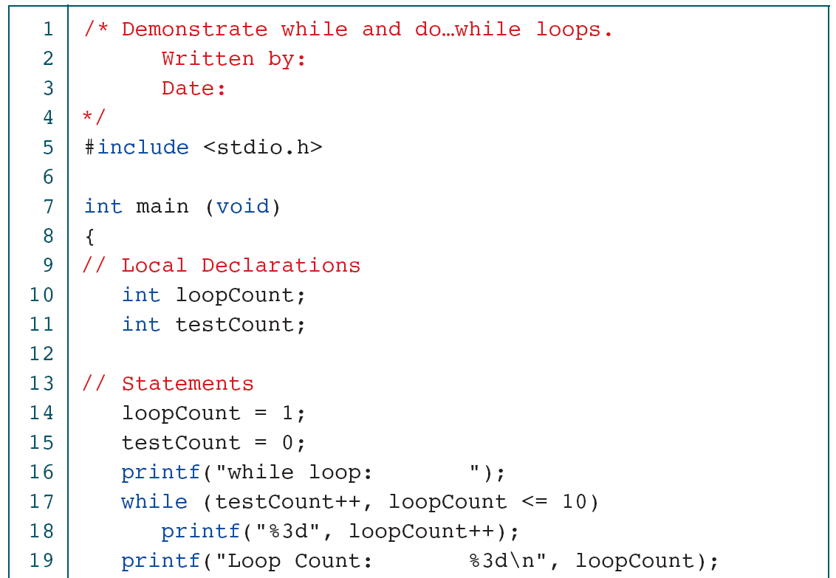
Comparison of while and do…while

Slide 24
Comparison of while and do…while

